Slide 1


Business Analyst Nano-Degree
Project 1:Interpret a Data Visualization
Submitted by:
Bhavita Thakore

Slide 2
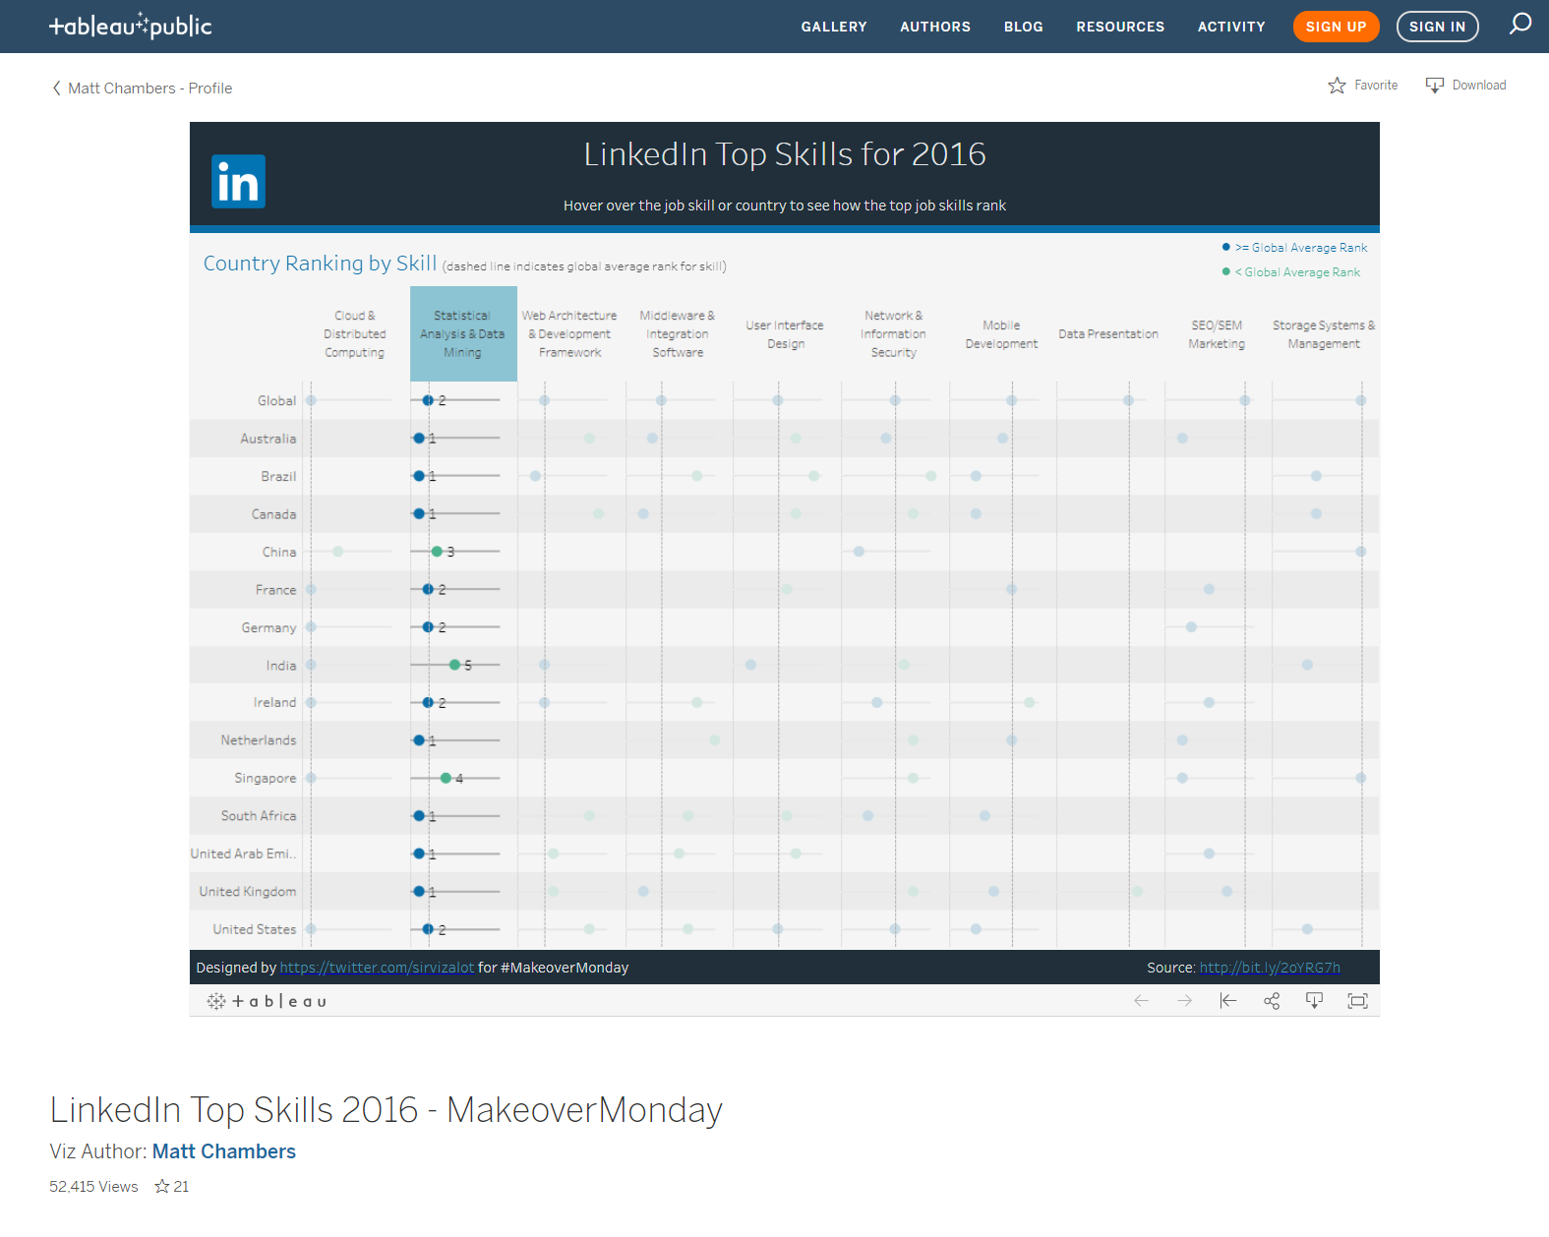
Insight # 1: Most competitive
In LinkedIn top skills for 2016 dashboard, when I clicked on Statistical Analysis and Data Mining skill column, it highlighted all 14 countries with good background in this skill. Among all the countries, 50% countries are ranked #1 which is higher compare to the global ranking. France, Germany, Ireland, and United States are ranked equal to global average rank which indicated that these countries have higher chances to exceed global average ranking in very near future. However, China, India, and Singapore have lower than global average ranking.
This stipulates that even though most countries are highly skilled and competitive in Data Mining, there can be geographical impact on employment opportunities considering there is still some room for it to expand.

Slide 3
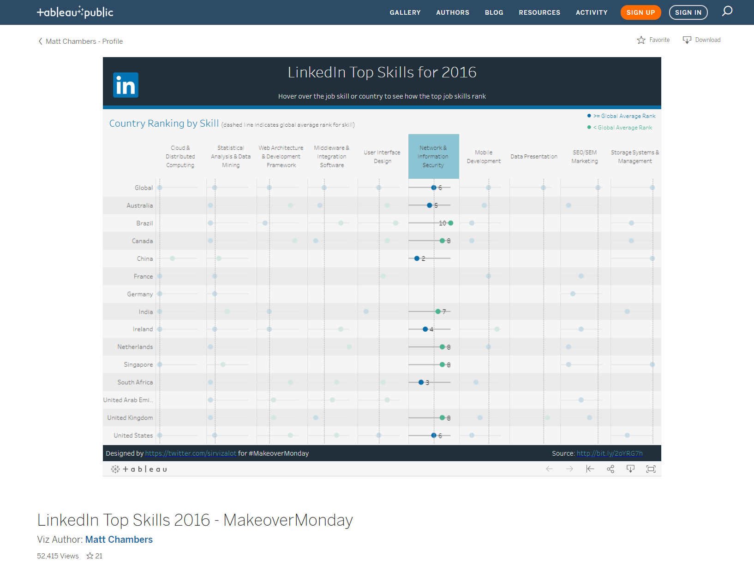
Insight # 2: More ranked, less averaged
Upon clicking and highlighting Network & Information Security in LinkedIn top skills for 2016 dashboard, it shows that it is the second highest ranked skill on global level. 11 out of 14 countries hold the background in this skill. However, the substantial number or countries fall under the lower average ranking than the global average which is more than 50%. Brazil is the lowest ranked here compare to global average.
The probability of this specific result is that the most countries would not adapt to maintain their own data centers, which would not require high proficiency in this skill.

Slide 4
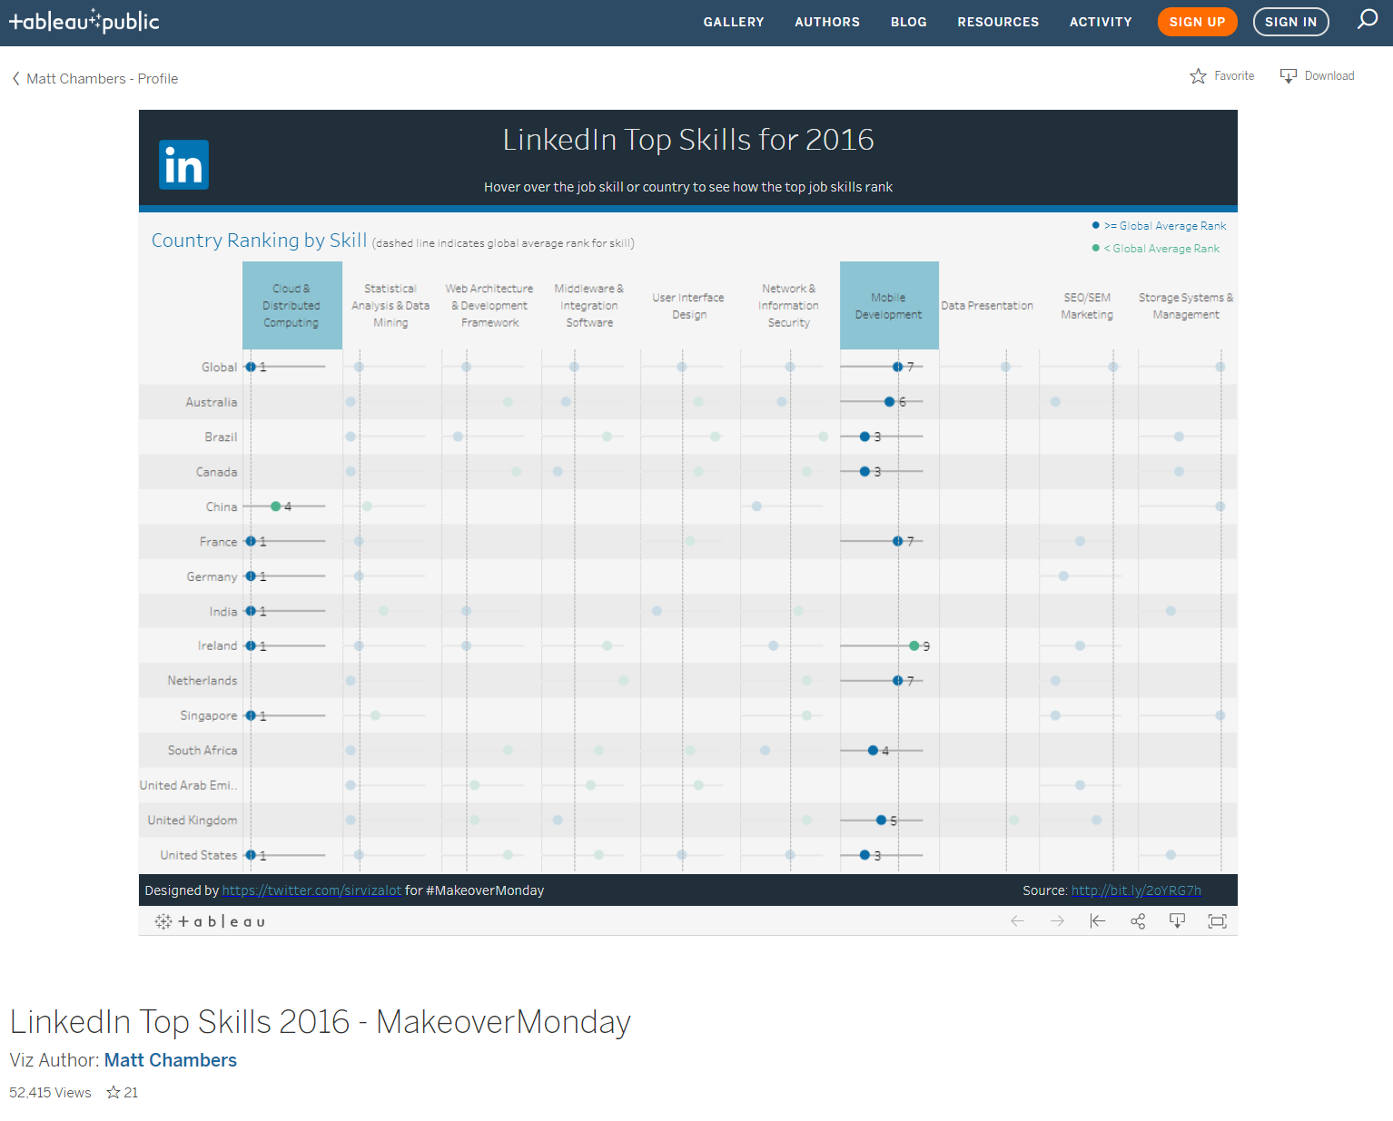
Insight # 3: The correlation
In LinkedIn top skills for 2016 dashboard, I clicked both Cloud & Distributed Computing and Mobile Development together to highlight since both are tied-in to a certain extent based on how the organizations would operate their services and products. Australia, Brazil, United Kingdom, Canada has no ranking in Cloud Computing whereas they all have higher ranking in Mobile Development compare to the global average. Similarly, Germany and India meets the global ranking in Cloud Computing but none in Mobile Development. Such results are due to the organizations that focus on services-based business, are more likely to leverage cloud-based service providers. For example, Netflix AWS. On the other hand, organizations that has control over their products, are more likely to create services based on their products and adapt to owning their own data centers and cloud infrastructure. For example, Facebook & Twitter. Organization like Google would provide both cloud platform and services and that is why United States ranks higher in both skills.

Slide 5
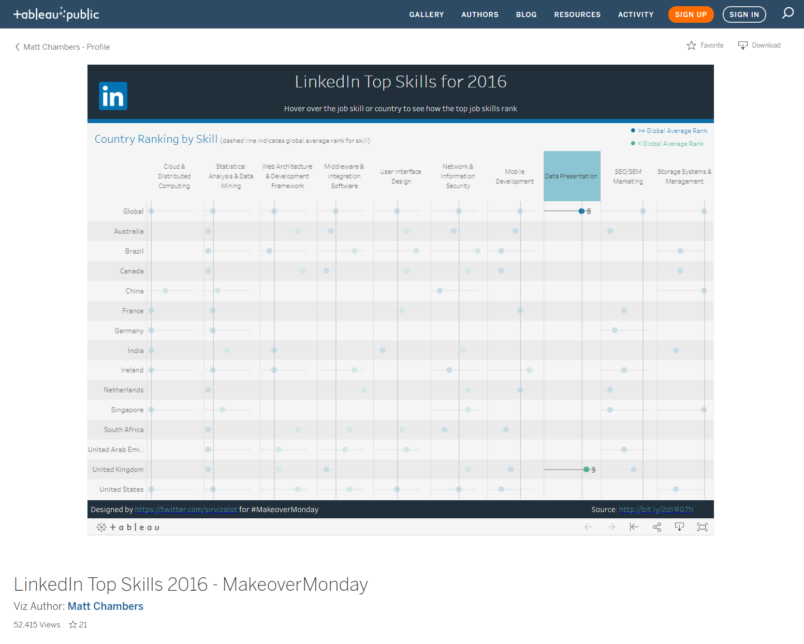
Insight # 4: The minor in league
In LinkedIn top skills for 2016 dashboard, I clicked on Data Presentation to highlight and show that only 1 out of 14 countries holds the ranking in Data Presentation and that is United Kingdom. It also has lower than global average ranking. When all 14 countries have good ranking in Data Mining, the probability of having only 1 country ranked in Data Presentation is very adverse. Nonetheless, the most countries highly ranked in Data Mining, there will be better opportunities of growth in having a greater number of countries ranked higher in Data Presentation in near future.

